Slide 1
STRUCTURAL ANALYSIS OF CRANE HOOK
GROUP NUMBER -13
MDM19B012-ANIL KUMAR SAINI
MDM19B042-NAMO NARAYAN

Slide 2
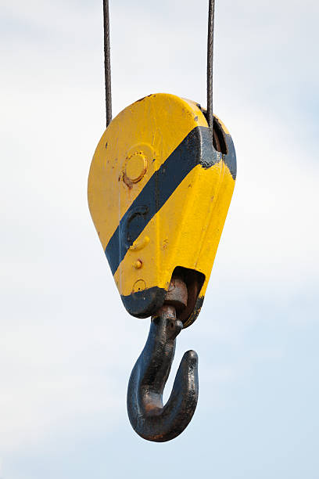
STRUCTURAL ANALYSIS OF CRANE HOOK
Crane hook is a common device for grabbing and lifting loads used by a hoist or crane.
Failure of crane hook mainly depends on three major factors i.e. dimension , material , overload .

Slide 3
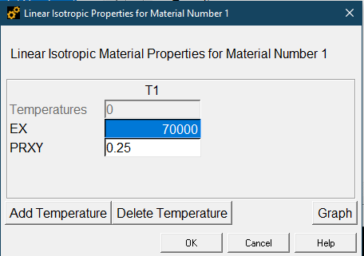
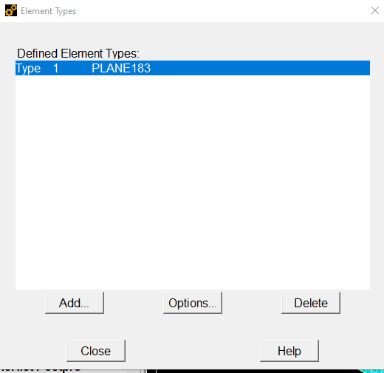
DEFINING ELEMENTS
Element - Solid 183
Material Model:
E = 70 GPa,
v = 0.25 (Poisson ratio)

Slide 4
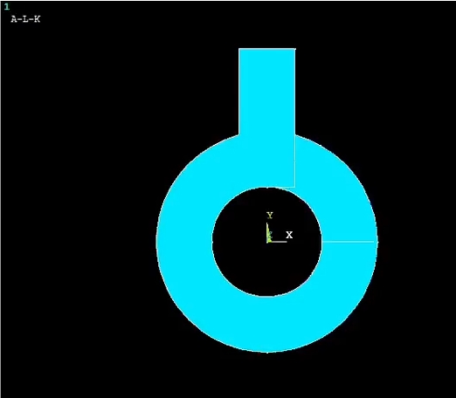
MODELING
For creating this model select Annulus Circle option. And give radius.
Ri = 20mm
Ro = 40mm
Then create rectangle by center and corner
Wpx = 0mm
Wpy = 45mm
Width = 20mm
Height = 50mm

Slide 5
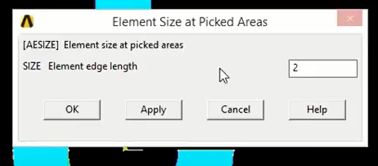
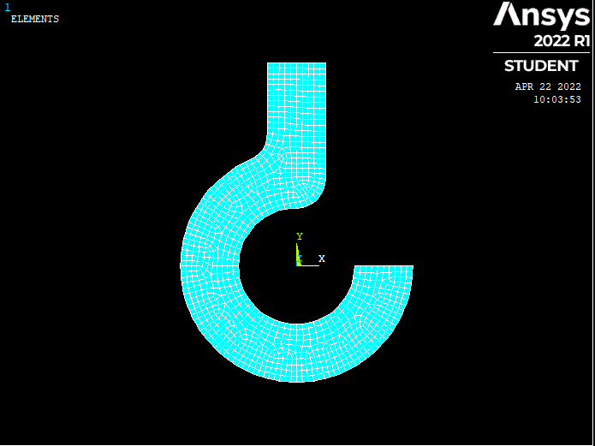
MESHING AND FILLET
Meshing:
Element edge length = 2mm
Used Fillet to make curve at the corner.
This is final model of Ansys Model

Slide 6
Boundary Condition
Displacement boundary condition:
At the top of hook = All DOF are 0
Force boundary condition
Maximum load = 1KN (Y- Downward direction)

Slide 7
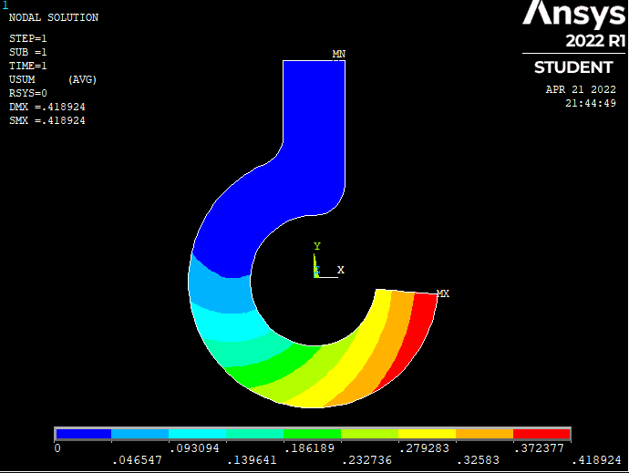
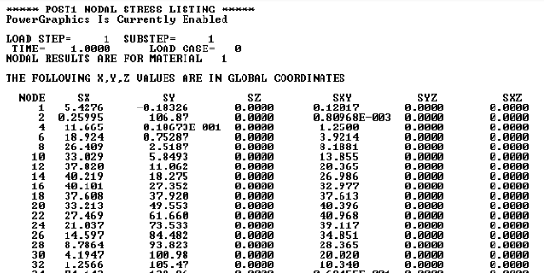
ANALYSIS:
Displacement Vector Sum

Slide 8
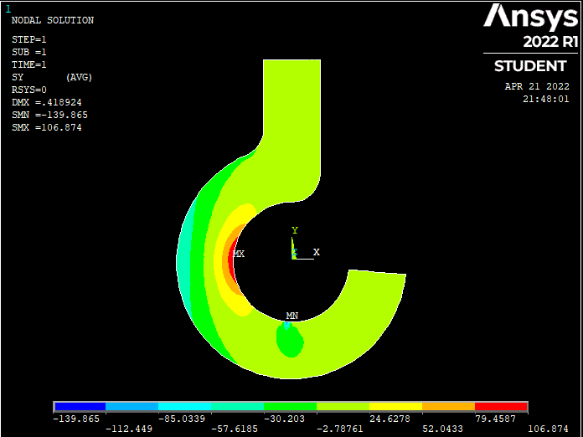
Stress Distribution
As we are applying force in downwards direction more
Stress is produce on inner surface of the crane hook.
Maximum stress = 106.972N/mm2
Minimum/Compressive stress = -53.7483

Slide 9
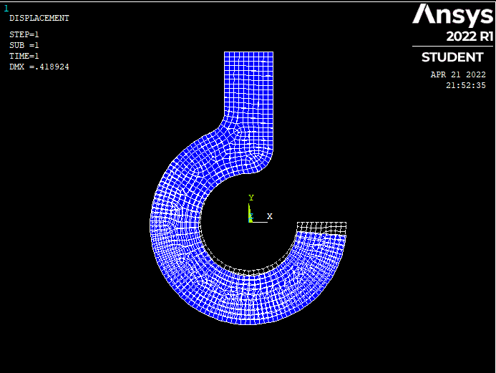
Deformed and Undeformed Shape
Blue Part: Deformed
Structural analysis of crane hook is done with Ansys Software.
Finally we got the deformed and undeformed Shape of the crane hook.

Slide 10
Thank You

